Slide 1
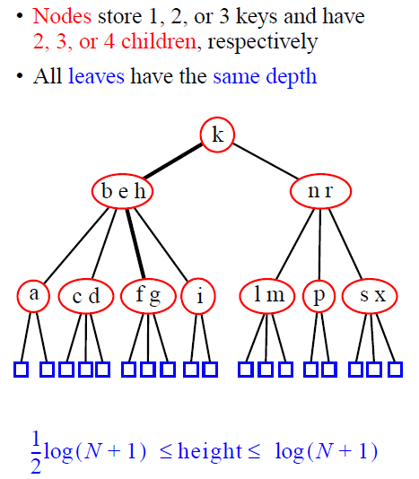
2-3-4 Trees

Slide 2
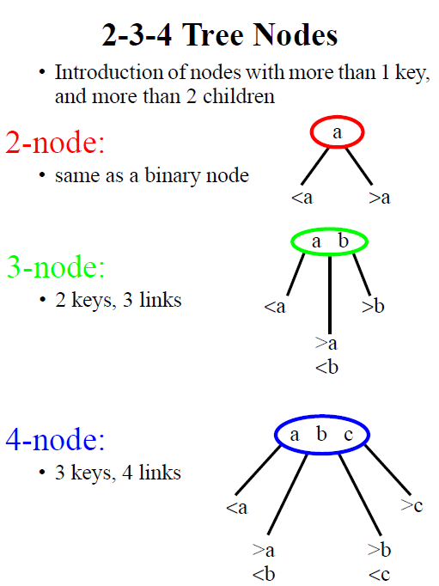

Slide 3
Top-Down Insertion
Allow to perform top-down insertion, in addition to bottom-up insertion in general B-tree
  Bottom-up insertion: search for a leaf and then bottom-up splitting (check prior lecture)
Will not discuss in this lecture

Slide 4
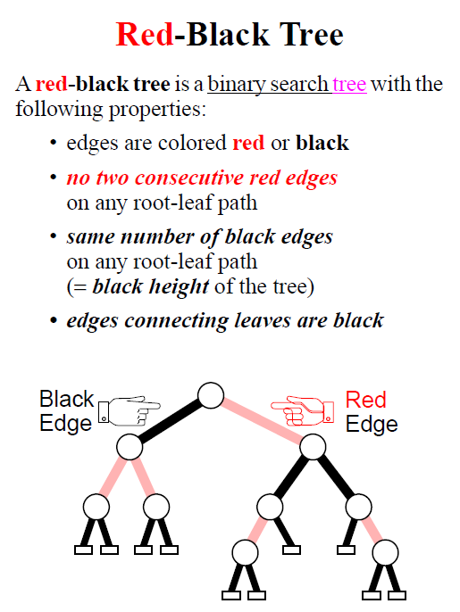

Slide 5
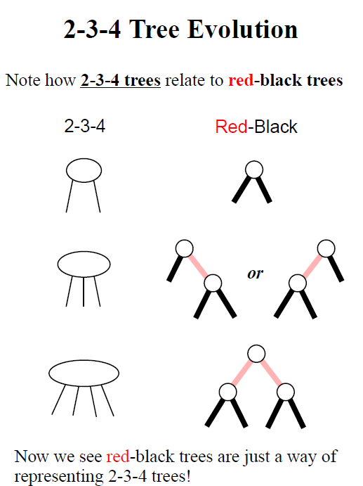

Slide 6
Example Red-Black Tree
10
7
40
45
3
8
30
35
60
1
5
20
25
Notes:
Height = 5

Slide 7
Properties
10
7
40
45
3
8
30
35
60
1
5
20
25
Notes:
Collapsed height = 3.

Slide 8
Red-Black Tree
Represent a 2-3-4 tree (B-tree) as a binary tree
Why? As search for elements in a m-way B-tree node takes O(log m-1) ~ O(log m)
Simulate a 2-3-4 node with a red-black tree
  作用在red-black tree的operations都能轉換成作用在2-3-4 tree上 and vice versus

Slide 9
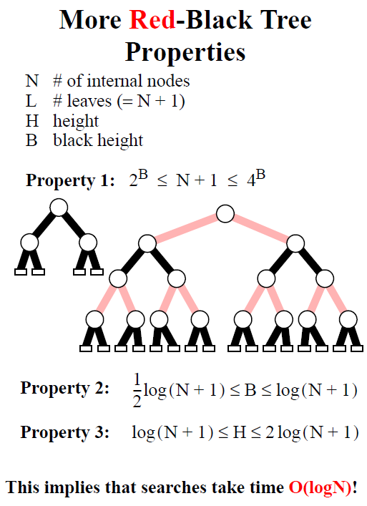

Slide 10
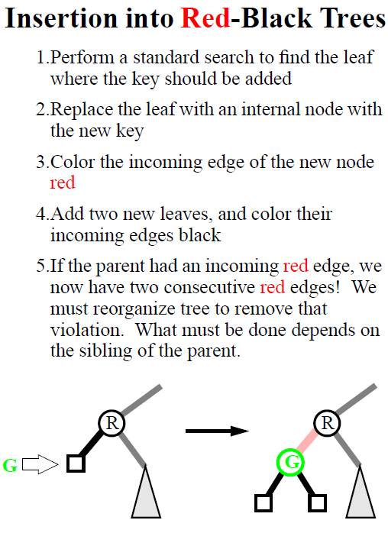

Slide 11
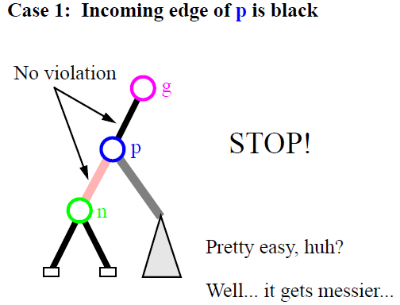

Insertion (Shall Insert in the Leaf)
black edge
這相當對2-3-4 tree的2-node插入一個element，並表為red-black tree

Slide 12
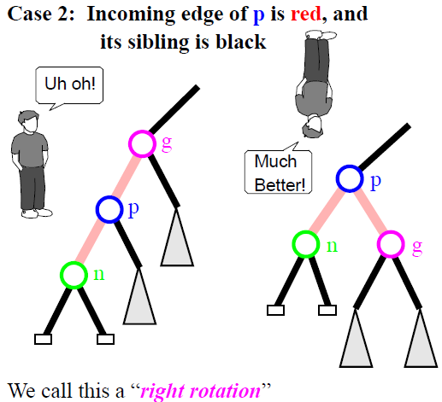
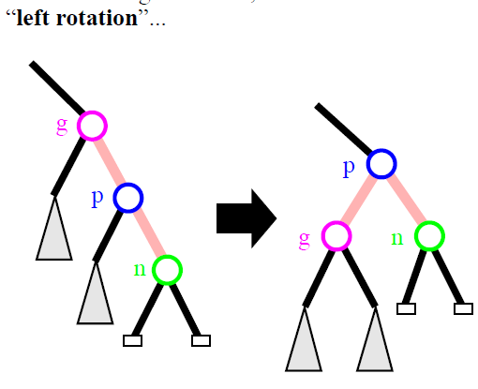
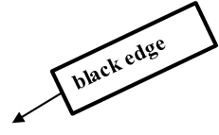
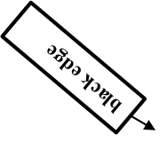
Insertion (Right and Left Rotation)
這相當對2-3-4 tree的3-node插入一個element，並表為red-black tree

Slide 13
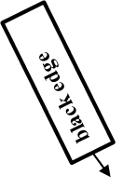
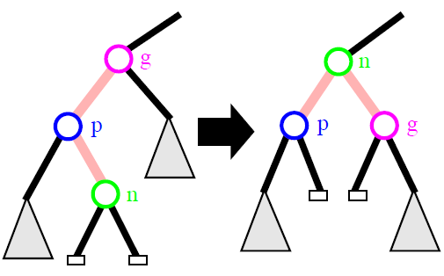
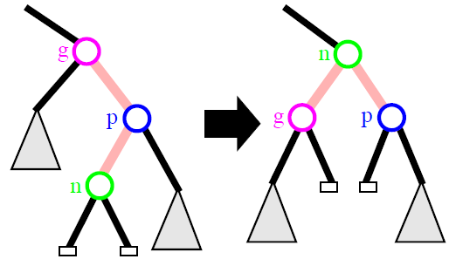

Insertion (LR Rotation)
LR
RL

Slide 14
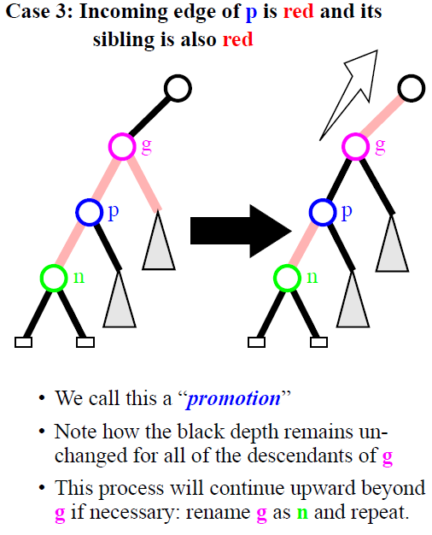
Bottom-Up Rebalancing
這相當對2-3-4 tree的4-node插入一個element，該node接著split，並且其中一個節點有p and n，我們將p and n以red-black tree來表達
red edge
// Color change

Slide 15
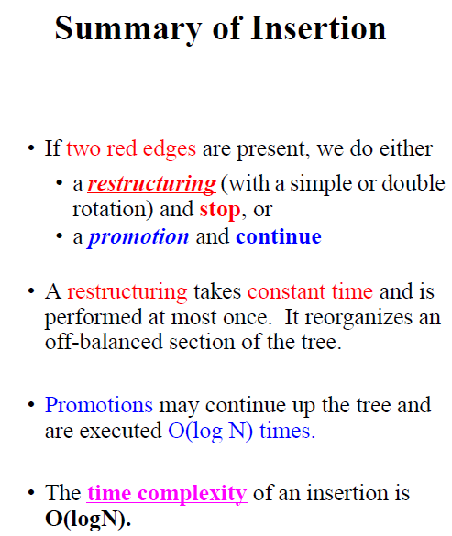

Slide 16
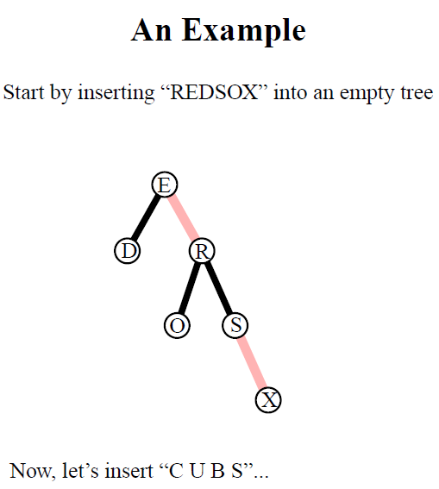
for Insertion

Slide 17
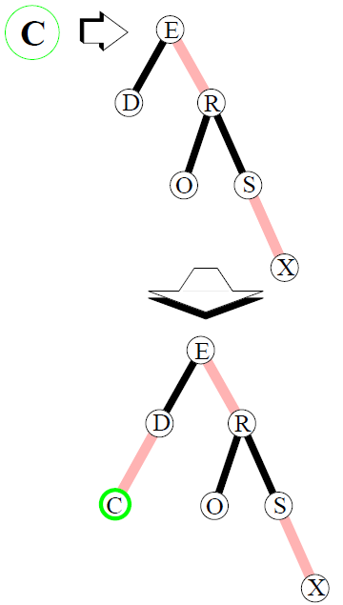

Slide 18
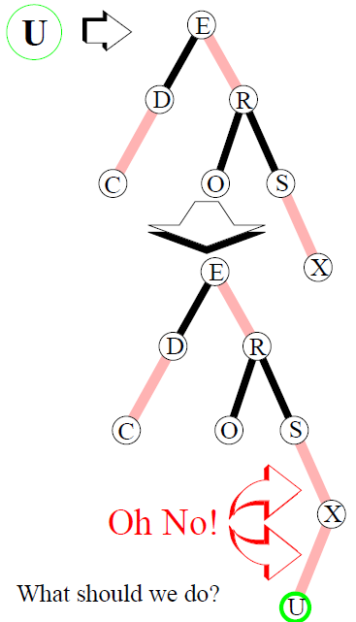

Slide 19
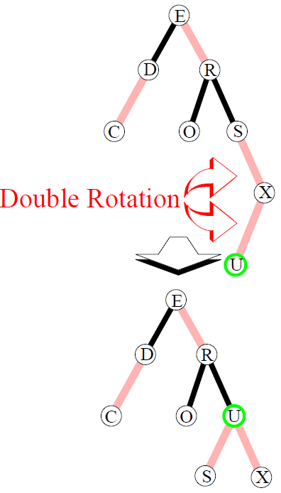

Slide 20
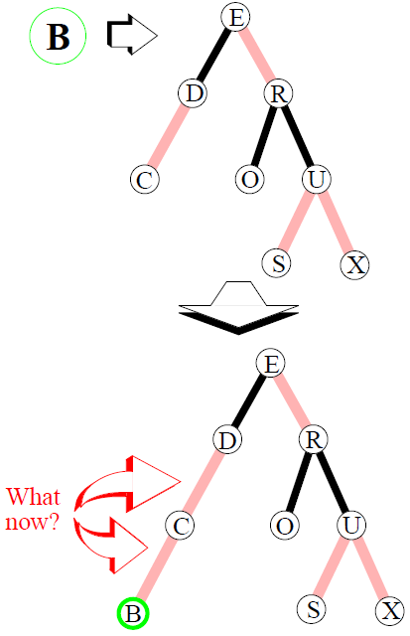

Slide 21
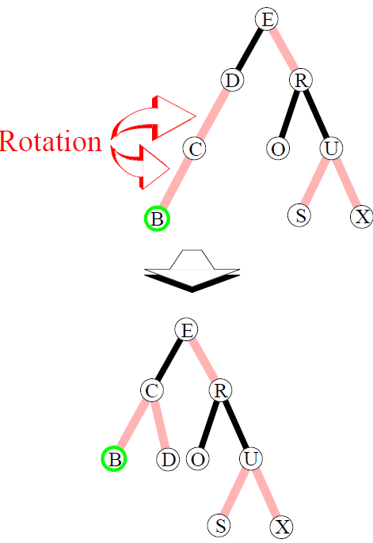

Slide 22
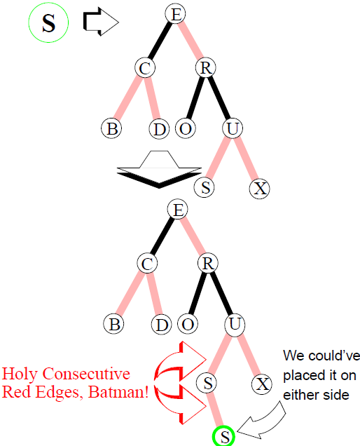

Slide 23
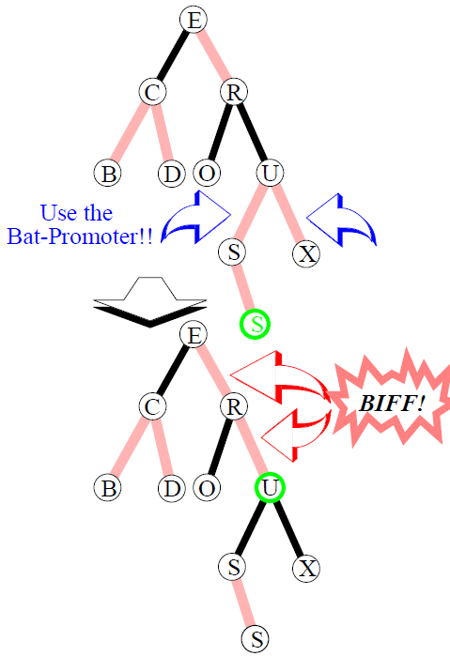

Slide 24
